Slide 1

Process and Thread Manager
Matthew Akinmolayan Andre' Herron Tobiloba Ayodeji Tobiloba ifenikalo

Slide 2
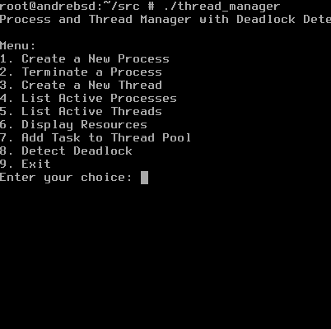
Project Overview
This project implements a Process and Thread Manager program.
Allows users to create and manage multiple processes and threads.
Implements process resource allocation and a thread pool.
Identifies potential deadlocks in the system

Slide 3
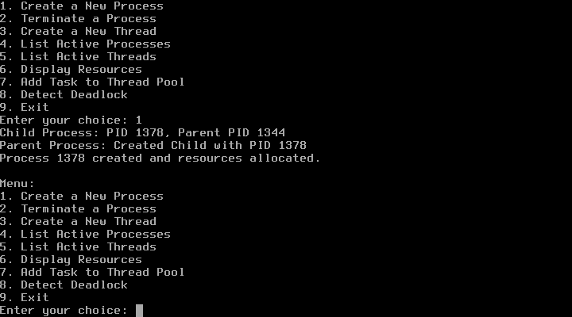
Process Creation
Calls fork() to create a child process of the programs main process.
The child's PID is added to the activeProcesses list.
Simulates work by using sleep() in a loop.
It requests a random number of resources between 0-5.

Slide 4



Process Termination
Terminates a specified process.
Deallocates the resources held.

Slide 5


Thread Management
3 functions: createThread(), listThreads(), and joinThreads().
For thread synchronization we used lock_guard to protect thread access to the activeThreads and threadPool vectors.
CreateThread() generates a new thread ID and adds the thread to activeThreads.
ListThreads() prints the number of threads that were created along with the threads in the thread pool.
JoinThreads() joins all joinable() threads in activeThreads.

Slide 6
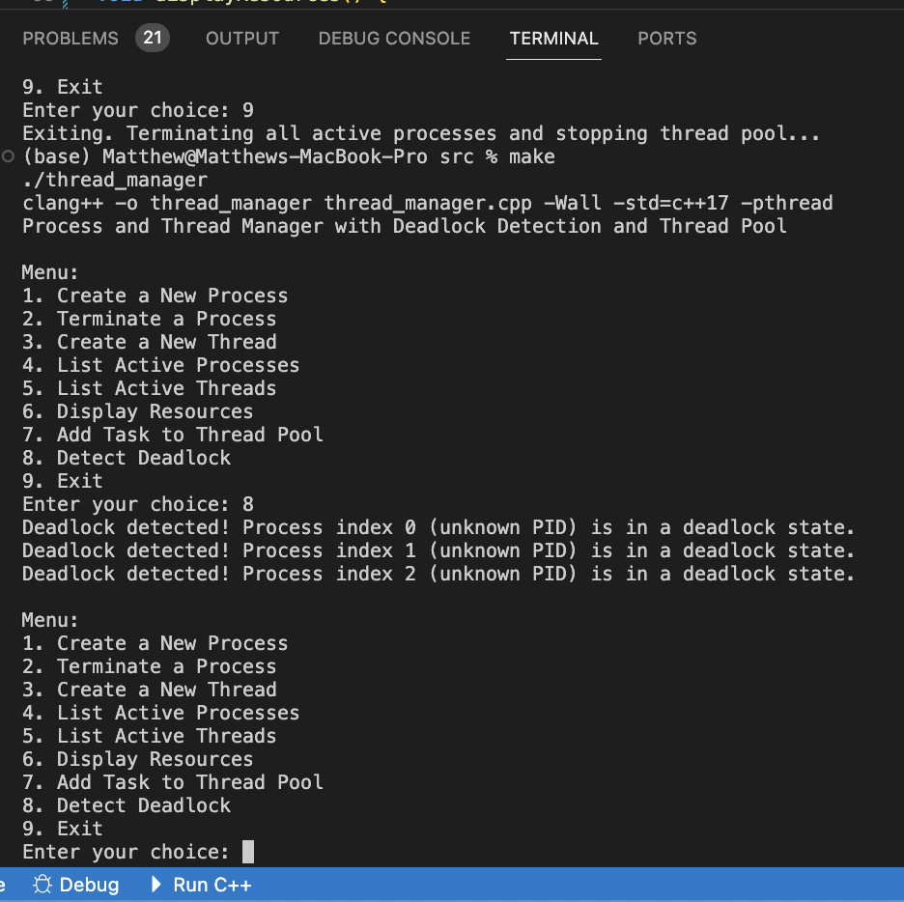
Deadlock manager
Purpose: To identify and resolve situations where processes are stuck waiting for resources held by other processes.
Methodology:
Uses a variation of the Banker's Algorithm.
Tracks resource Allocation, Requests, and Availability using matrices.
Analyzes if any processes are unable to complete due to unfulfilled requests.
Output:
Reports processes in a deadlock state, if any.
Otherwise, confirms that no deadlock is detected.

Slide 7
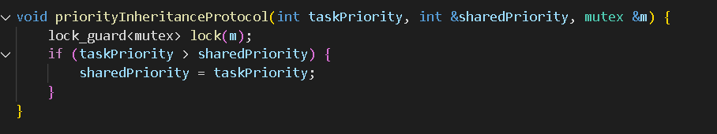
Priority Inheritance
Purpose: Prevents priority inversion by temporarily elevating the priority of a lower-priority task holding a shared resource
Methodology:
A low-priority task locks a resource
A high-priority task is blocked, waiting for the resource
Priority inheritance occurs, where the low-priority task inherits the high priority
After releasing the resource, the low-priority task restores its original priority

Slide 8
Shared Memory
Purpose: Enables quick data transfer across processes by permitting several processes to access the same memory address.
Methodology:
Allocate a shared memory segment
Attach processes to the shared memory
Effective inter-process communication is made possible by read/write operations being carried out directly in the shared memory.

